Slide 1
Welcome to Ensure
Proactive Third-Party Data Security in partnership with IIABA

Slide 2
https://www.ensureendpoint.com/act/
GO TO
Notes:
I will focus on two areas during this presentation: The problem (as we see it) and how our platform can help you mitigate this problem.

Slide 3
https://www.ensureendpoint.com/act/
Notes:
I will focus on two areas during this presentation: The problem (as we see it) and how our platform can help you mitigate this problem.

Slide 4
https://www.ensureendpoint.com/act/
Notes:
I will focus on two areas during this presentation: The problem (as we see it) and how our platform can help you mitigate this problem.

Slide 5
https://www.ensureendpoint.com/act/
Notes:
I will focus on two areas during this presentation: The problem (as we see it) and how our platform can help you mitigate this problem.

Slide 6
https://www.ensureendpoint.com/act/
Notes:
I will focus on two areas during this presentation: The problem (as we see it) and how our platform can help you mitigate this problem.

Slide 7
https://www.ensureendpoint.com/act/
Notes:
I will focus on two areas during this presentation: The problem (as we see it) and how our platform can help you mitigate this problem.

Slide 8
https://www.ensureendpoint.com/act/
Notes:
I will focus on two areas during this presentation: The problem (as we see it) and how our platform can help you mitigate this problem.

Slide 9
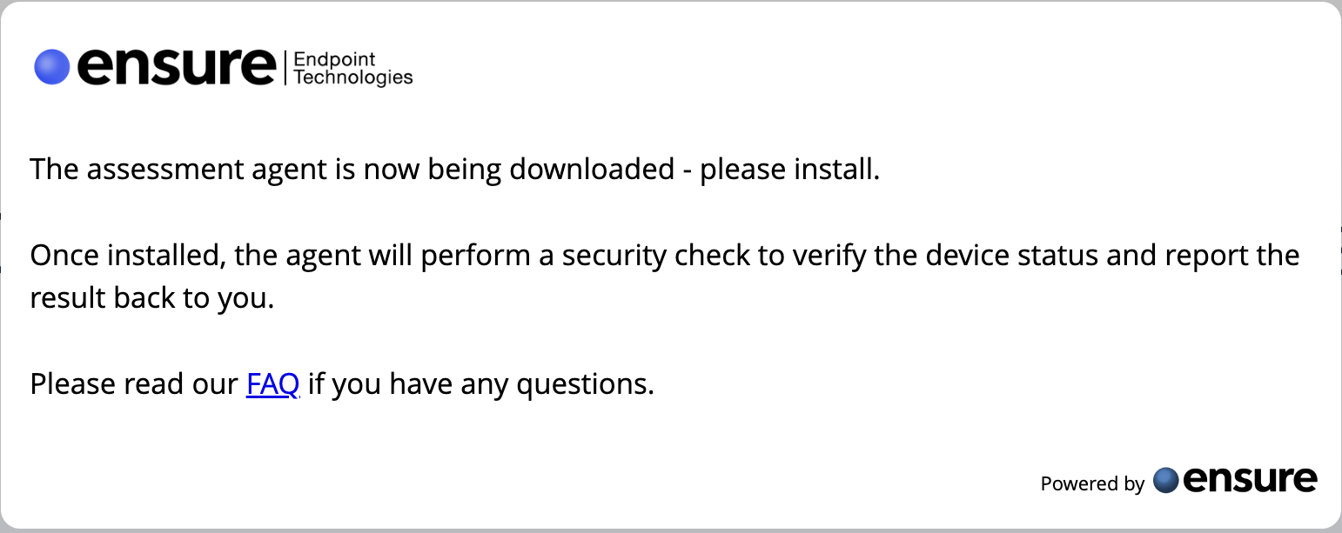
https://www.ensureendpoint.com/act/
Notes:
I will focus on two areas during this presentation: The problem (as we see it) and how our platform can help you mitigate this problem.

Slide 10
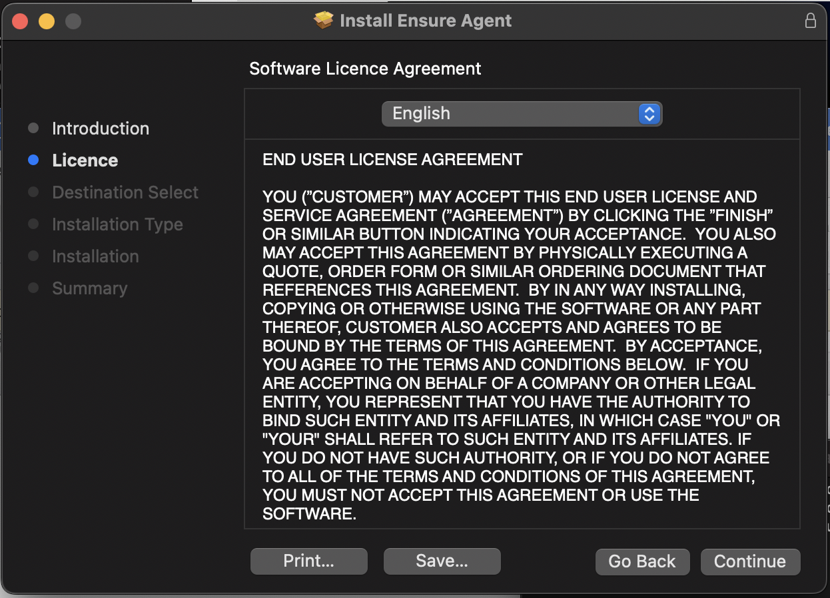
https://www.ensureendpoint.com/act/
Notes:
I will focus on two areas during this presentation: The problem (as we see it) and how our platform can help you mitigate this problem.

Slide 11
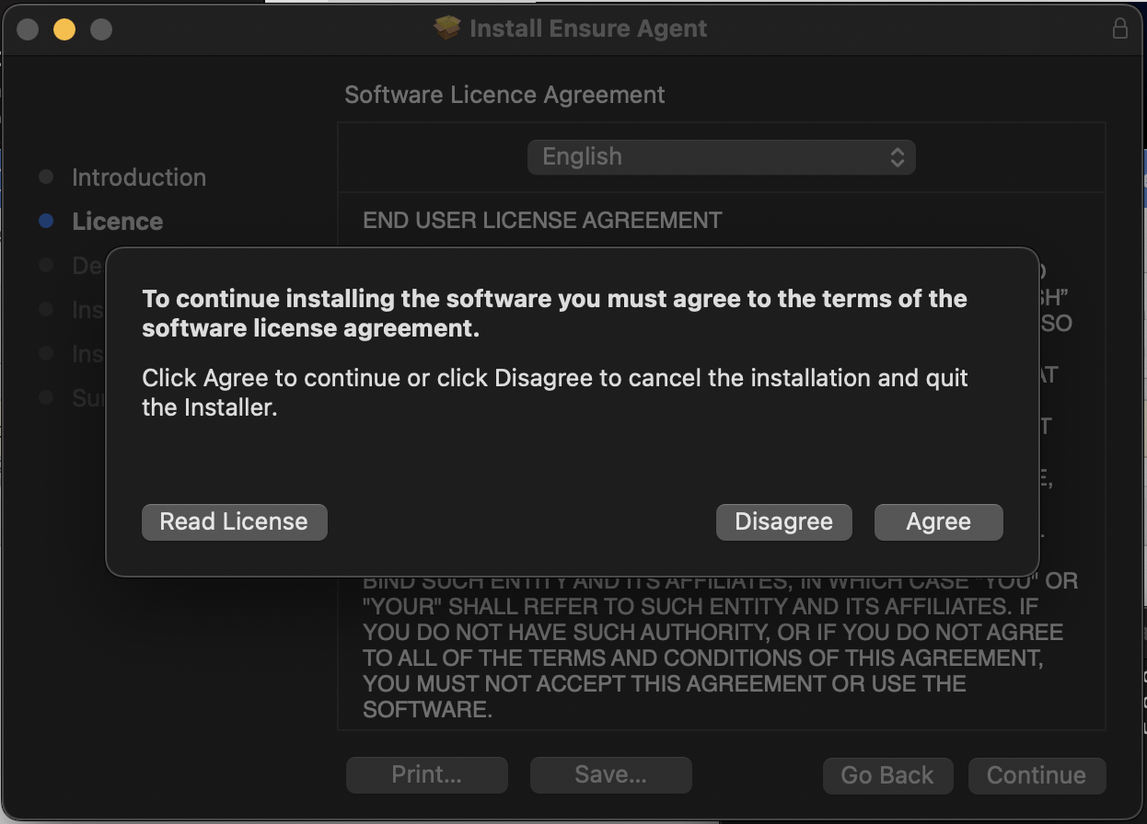
https://www.ensureendpoint.com/act/
Notes:
I will focus on two areas during this presentation: The problem (as we see it) and how our platform can help you mitigate this problem.

Slide 12
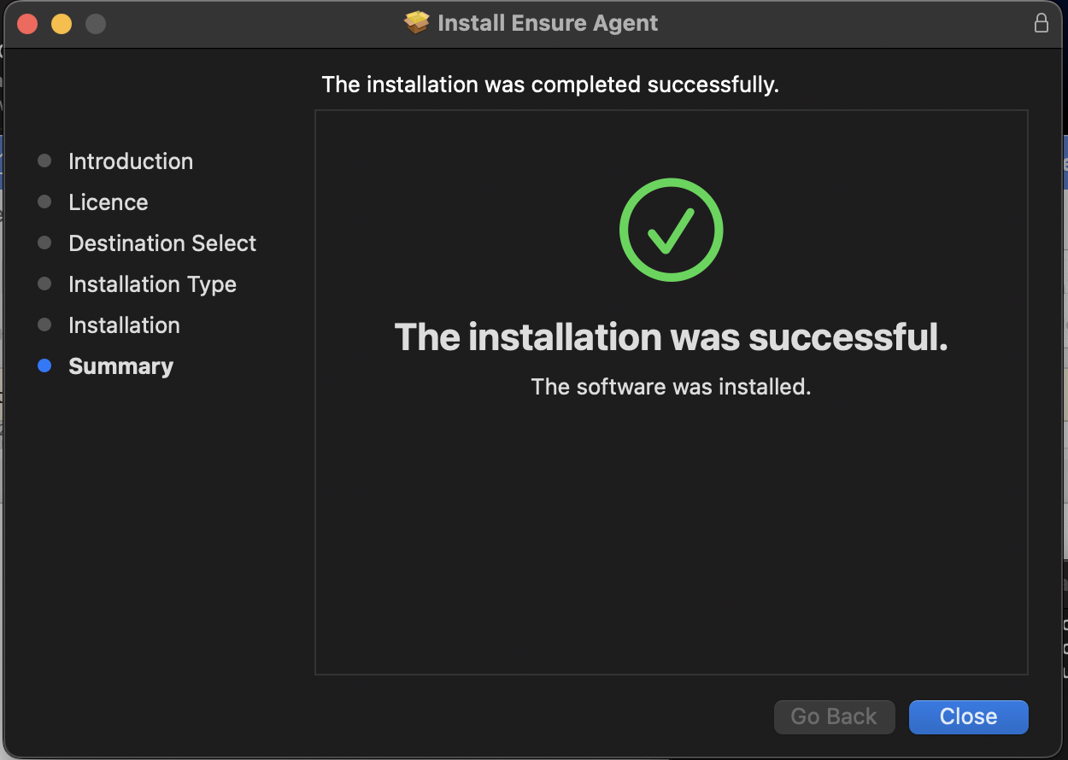
https://www.ensureendpoint.com/act/
Notes:
I will focus on two areas during this presentation: The problem (as we see it) and how our platform can help you mitigate this problem.

Slide 13
https://www.ensureendpoint.com/act/
Notes:
I will focus on two areas during this presentation: The problem (as we see it) and how our platform can help you mitigate this problem.

Slide 14
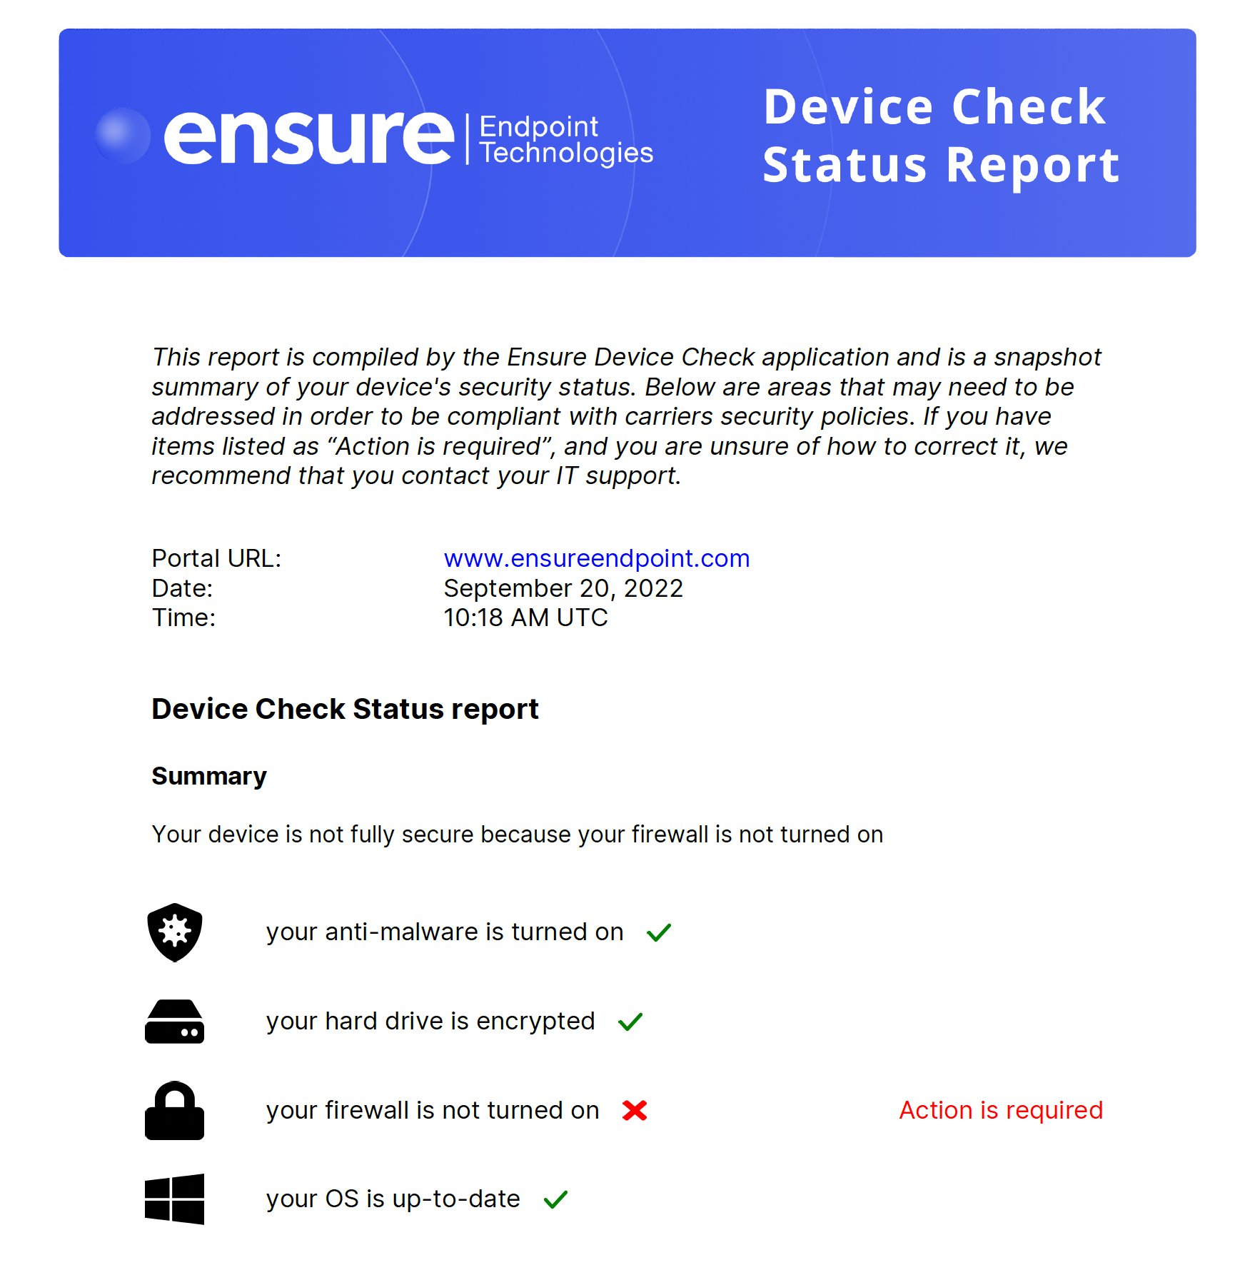
https://www.ensureendpoint.com/act/
Notes:
I will focus on two areas during this presentation: The problem (as we see it) and how our platform can help you mitigate this problem.

Slide 15
https://www.ensureendpoint.com/act/
Notes:
I will focus on two areas during this presentation: The problem (as we see it) and how our platform can help you mitigate this problem.

Slide 16
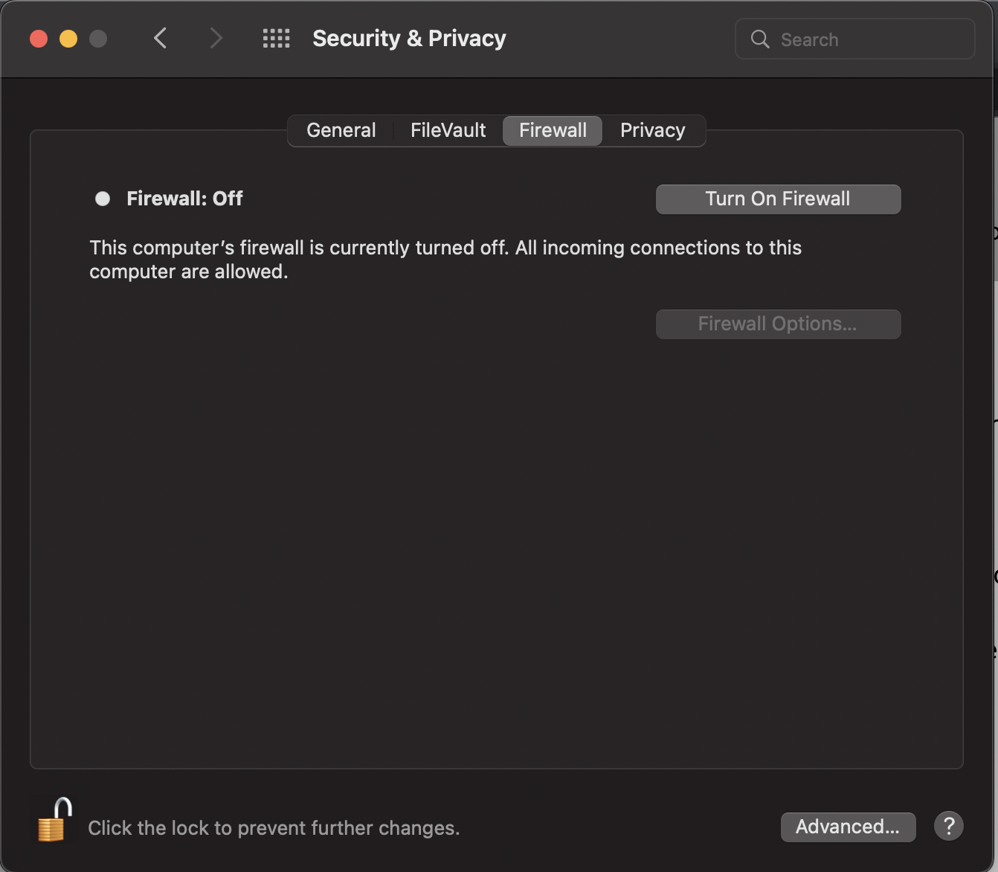
https://www.ensureendpoint.com/act/
Notes:
I will focus on two areas during this presentation: The problem (as we see it) and how our platform can help you mitigate this problem.

Slide 17
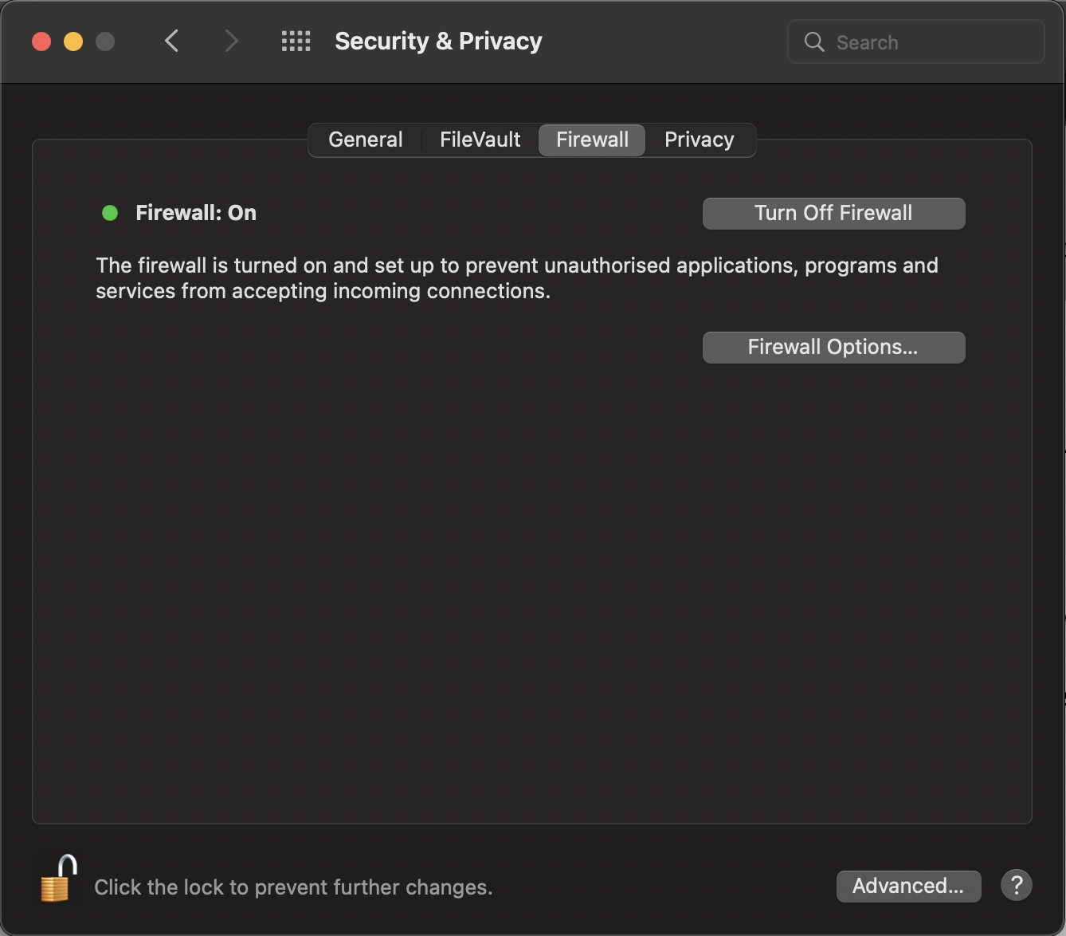
https://www.ensureendpoint.com/act/
Notes:
I will focus on two areas during this presentation: The problem (as we see it) and how our platform can help you mitigate this problem.

Slide 18
https://www.ensureendpoint.com/act/
Notes:
I will focus on two areas during this presentation: The problem (as we see it) and how our platform can help you mitigate this problem.

Slide 19
https://www.ensureendpoint.com/act/
Notes:
I will focus on two areas during this presentation: The problem (as we see it) and how our platform can help you mitigate this problem.

Slide 20
https://www.ensureendpoint.com/act/
Notes:
I will focus on two areas during this presentation: The problem (as we see it) and how our platform can help you mitigate this problem.

Slide 21
Thank you!

